Slide 1
AIR QUALITY MONITORING AND ALERT SYSTEM
TEAM MEMBERS:
Arjun Pradeep
Chackochan Sebastian
Hrithul P B
GUIDE:
Ms. Susmi Jacob
Assistant Professor
Dept. Of CSE
SSET Ernakulam

Slide 2
CONTENTS
Introduction
Problem Statement
Objective
Motivation
Existing and Proposed System
Requirements
Architecture
Circuit Diagram
Working
Result
Output
Conclusion
Scope For Future
References

Slide 3
INTRODUCTION
Clean air is vital for our overall health and well-being, and indoor environments can sometimes harbor pollutants that go unnoticed.
Our Air Quality Monitoring and Alert System addresses this issue by continuously monitoring the air quality parameters, including the presence of various harmful gases such as carbon monoxide (CO), nitrogen dioxide (NO2), ammonia (NH3), benzene (C6H6), and many others.
By accurately detecting, analyzing and alerting about these gases, our system helps create safer and healthier living environments.

Slide 4
MOTIVATION
Indoor air pollution is a significant health risk in households.
Harmful gases can accumulate indoors, leading to respiratory issues and long-term health complications.
Existing solutions for monitoring indoor air quality are often expensive and complex.
Our motivation is to provide an affordable and user-friendly solution to monitor and alert users about harmful gases in their homes.
By raising awareness and enabling proactive measures, we aim to create healthier indoor environments for individuals and families.

Slide 5
PROBLEM STATEMENT
The problem we aim to solve is the lack of efficient and affordable air quality monitoring systems for households, specifically targeting the detection of harmful gases.
Ensure health and safety in households.

Slide 6
OBJECTIVE
To develop and implement an affordable, user-friendly Air Quality Monitoring and Alert System, leveraging the MQ-135 sensor.
To provide real-time detection, and deliver intelligent alerts for harmful gases in households, ensuring safer and healthier indoor environments.
To raise public awareness about air pollution and its impact on public health.

Slide 7
LITERATURE SURVEY
Rawal, Ramik. "Air Quality Monitoring System." | Air pollution is a growing concern, and the study proposes an IoT-based air quality monitoring system that provides real-time measurements of pollution levels accessible from anywhere, addressing the need for accurate and accessible air quality data.
Husain, Ashish M. "Air quality monitoring: The use of arduino and android." | The study introduces a cost-efficient and portable Arduino-based air quality monitoring device that collects data on harmful gases and dust levels, allowing for data transfer to an Android phone or PC/laptop. This device enables remote analysis and decision-making for addressing air quality concerns.
Jabbar, Waheb A."LoRaWAN-based IoT system implementation for long-range outdoor air quality monitoring." | The study introduces LoRaWAN-IoT-AQMS, an outdoor air quality monitoring system that utilizes LoRaWAN-based IoT technology to collect and transmit data on various air quality indicators. The system includes sensors, an Arduino microcontroller, and is powered by a rechargeable battery with a photovoltaic solar panel for sustainable operation. The system demonstrates reliable and efficient monitoring with real-time data transmission over the internet.

Slide 8
EXISTING SYSTEM
Existing air quality monitoring systems face several challenges that limit their effectiveness and widespread adoption. Some of the common problems include:
Cost: Many existing air quality monitoring systems are expensive, making them inaccessible for average households. The high cost can be attributed to the complexity of the technology, advanced sensors, and data processing capabilities.
Limited Scalability: Some air quality monitoring systems are designed for larger-scale environments such as industrial settings or commercial buildings. These systems may not be suitable or scalable for individual households, where different monitoring needs and spatial constraints exist.
Complex Installation: Certain monitoring systems require professional installation or technical expertise, making them less user-friendly for homeowners. Complex installation processes can deter users from adopting such systems or hinder the widespread implementation.

Slide 9
PROPOSED SYSTEM
Affordable and User-friendly: Our proposed system is designed to be affordable and user-friendly, making it accessible to homeowners for effective air quality monitoring.
MQ-135 Gas Sensor: The system utilizes the highly sensitive MQ-135 gas sensor to detect and monitor a wide range of harmful gases in indoor environments.
Intelligent Alert System: An intelligent alert system is integrated into the system, triggering alarms, such as a buzzer and LED indicators, when gas concentrations exceed safe thresholds.
Easy Installation and Wireless Connectivity: The system is designed for easy installation without requiring specialized expertise. It also offers wireless connectivity for remote access to data and monitoring capabilities.

Slide 10
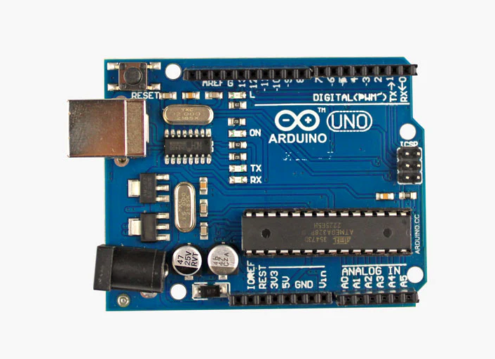
HARDWARE REQUIREMENTS
Arduino Uno:
Arduino Uno is a popular microcontroller board based on the ATmega328P chip. It serves as the brain of the system, responsible for executing the code and controlling other components.

Slide 11
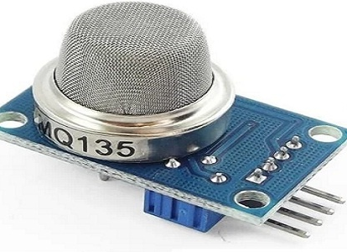
HARDWARE REQUIREMENTS
MQ-135 Gas Sensor:
The MQ-135 sensor is a highly sensitive gas sensor capable of detecting a wide range of harmful gases such as carbon monoxide, nitrogen dioxide, ammonia, and benzene. It measures the concentration of these gases in the air and provides analog output signals.

Slide 12
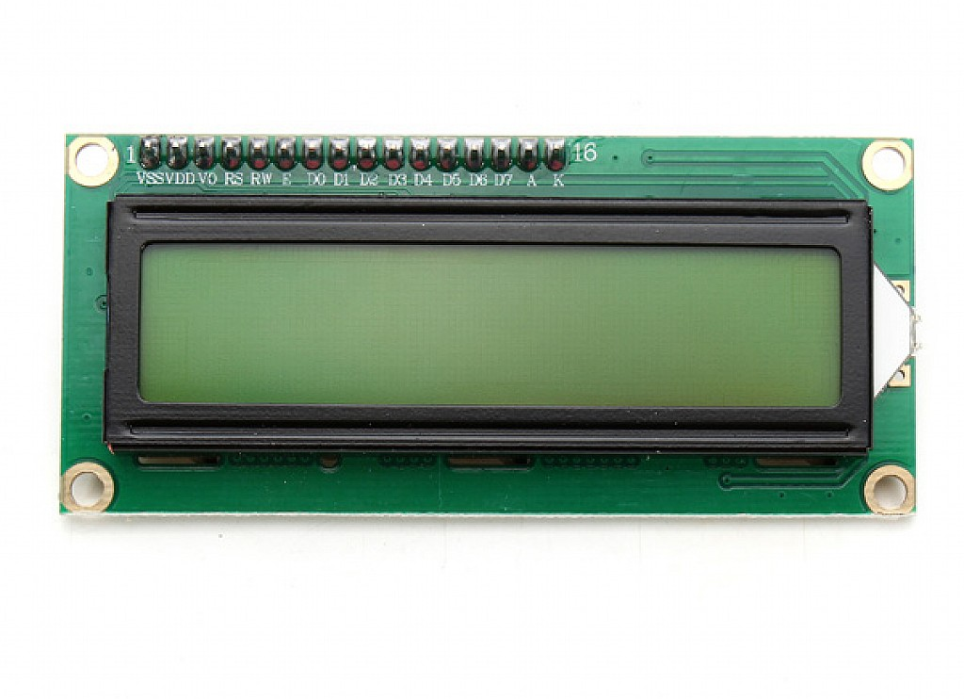
HARDWARE REQUIREMENTS
Breadboard or PCB (Printed Circuit Board) - To create a circuit prototype.
Jumper wires - To establish connections between the components.
LCD Display - To provide real-time information and display air quality data.

Slide 13
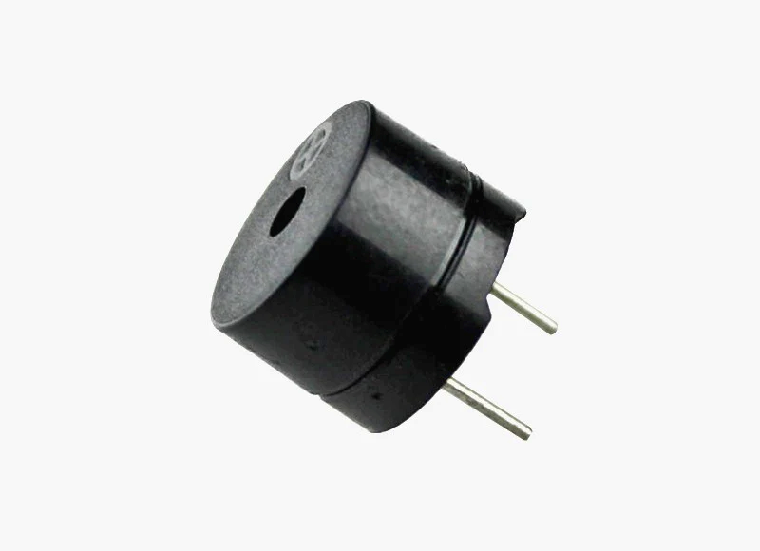
HARDWARE REQUIREMENTS
Buzzer - To generate audible alerts when gas levels exceed safe thresholds.
Potentiometer - To adjust the contrast of the LCD display.
Power Supply - To power the Arduino and the entire system, which can be a USB cable or an external power source.
LEDs (Light Emitting Diodes) - LEDs can be used to indicate different states or air quality.

Slide 14

SOFTWARE REQUIREMENTS
Arduino IDE - Integrated Development Environment used for programming the Arduino board.
Arduino Libraries - Install the necessary libraries for the MQ-135 sensor and the LCD display.
Programming Language - Utilize Arduino programming language (based on C/C++) to write the code for the air pollution monitoring and alert system.

Slide 15
BLOCK DIAGRAM
LCD Display
LEDs
MQ-135
Arduino Uno
Buzzer
Power Supply

Slide 16
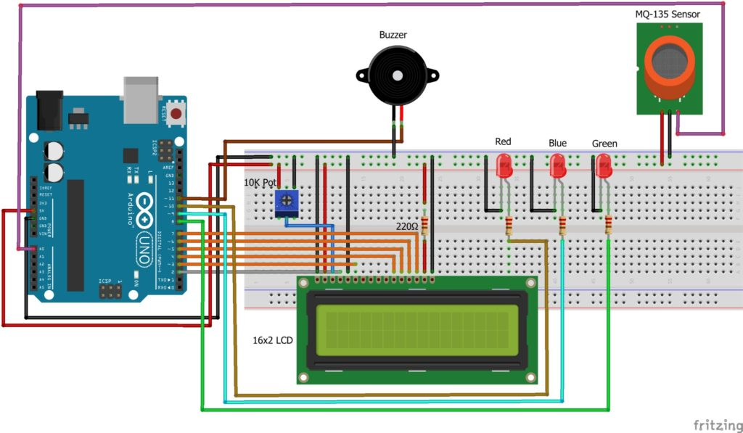
CIRCUIT DIAGRAM

Slide 17
WORKING
Gas Detection: The system utilizes the MQ-135 gas sensor to detect and measure the concentration of harmful gases in the indoor environment. The sensor is highly sensitive and capable of detecting gases such as carbon monoxide, nitrogen dioxide, ammonia, and benzene.
Data Processing: The sensor readings are collected and processed by the Arduino Uno board, which serves as the central processing unit of the system. The Arduino board converts the analog readings from the gas sensor into meaningful digital values for further analysis.
Threshold Comparison: The system compares the digital values obtained from the gas sensor against pre-defined thresholds for air quality. These thresholds determine the safe levels of gas concentration. If the measured gas concentrations exceed the safe thresholds, the system proceeds to activate the alert system.

Slide 18
WORKING
Alert System Activation: When the gas concentrations exceed the safe thresholds, an intelligent alert system is triggered. The system activates a buzzer to generate audible alerts and illuminates LED indicators to provide a visual indication of the severity of the air quality issue.
User Monitoring and Action: Homeowners can monitor the air quality levels in real-time through the user-friendly LCD display provided by the system. The display shows the detected gas concentrations and any active alerts. Upon receiving the alerts, users can take appropriate actions, such as opening windows for ventilation, identifying potential sources of pollution, or seeking professional assistance.

Slide 19
RESULT
The system has successfully detected and alerted users to instances where harmful gas concentrations exceeded safe thresholds.
By actively monitoring air quality, we are able to identify potential sources of pollution and take measures to mitigate them, improving the overall air quality in their households.
The system's user-friendly LCD display has allowed homeowners to easily monitor real-time gas concentration levels and stay informed about the air quality conditions at all times.

Slide 20
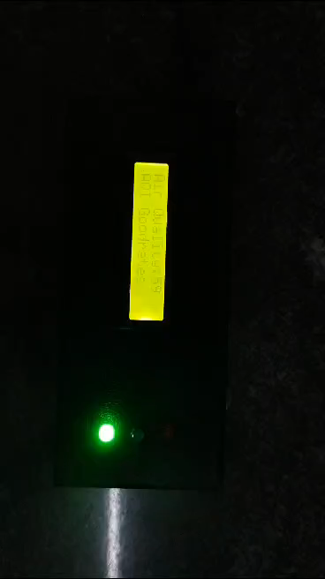
OUTPUT

Slide 21
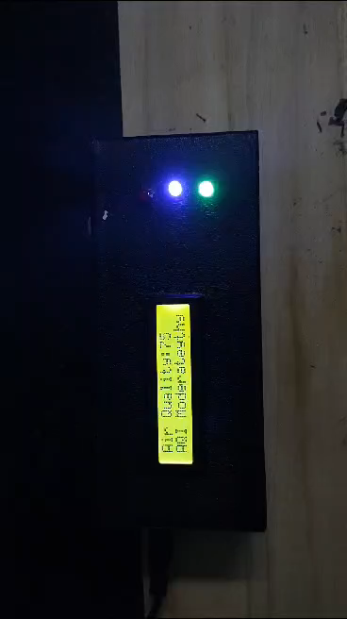
OUTPUT – Smoke Detection

Slide 22
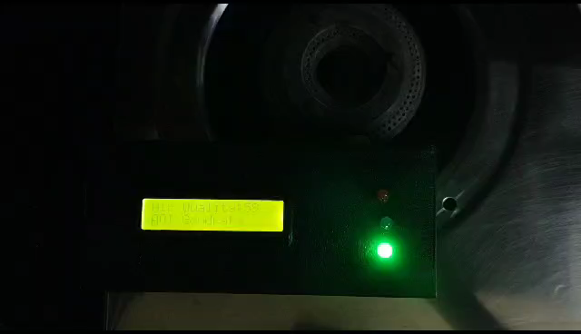
OUTPUT – Gas Leakage

Slide 23
CONCLUSION
In conclusion, this project has successfully addressed the need for an efficient and accessible air quality monitoring system.
By combining the capabilities of Arduino, MQ135 gas sensor, and data analysis techniques, we have developed a reliable solution that contributes to a healthier and safer environment.
Continued advancements in this field will further enhance our ability to monitor air quality and implement effective measures to combat air pollution

Slide 24
SCOPE FOR FUTURE
Integration of Additional Sensors
Data Analytics and Insights
Mobile Application Development
Real-Time Data Sharing and Collaboration

Slide 25
REFERENCE
[1]. Rawal, Ramik. "Air Quality Monitoring System." International Journal of Computational Science and Engineering 9.1 (2019): 1-9.
[2]. Husain, Ashish M., et al. "Air quality monitoring: The use of arduino and android." Journal of Modern Science and Technology 4.1 (2016): 86-96.
[3]. Jabbar, Waheb A., et al. "LoRaWAN-based IoT system implementation for long-range outdoor air quality monitoring." Internet of Things 19 (2022): 100540.

Slide 26
THANK YOU

